Slide 1
Chapter 2 Divide and Conquer
School of Science, Yanshan University
Wang Gang

Slide 2
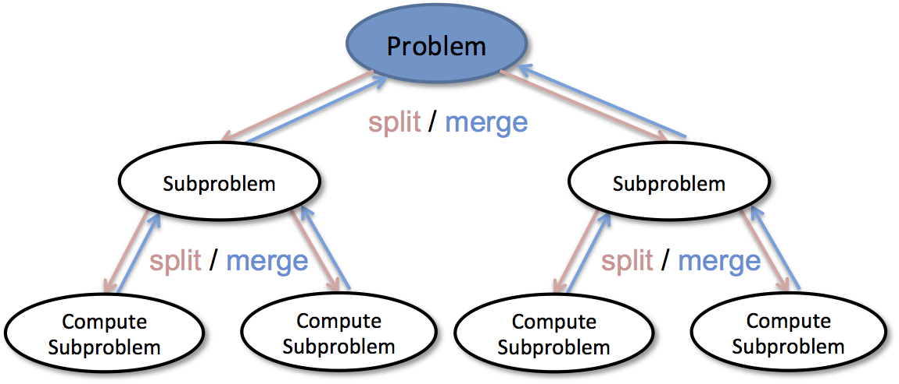
Divide-and-Conquer Algorithms
The divide-and-conquer strategy solves a problem by:
Divide: Break the given problem into subproblems of same type.
Conquer: Recursively solving these subproblems.
Combine: Appropriately combining their answers.

Slide 3
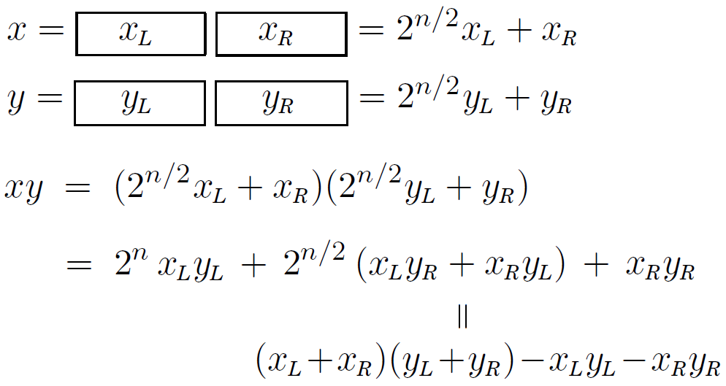
Multiplying Large Numbers
Problem: Multiply two n-digit numbers.
Standard Algorithm, Khwarizmi Algotihm .
Karatsuba Algorithm .

Slide 4
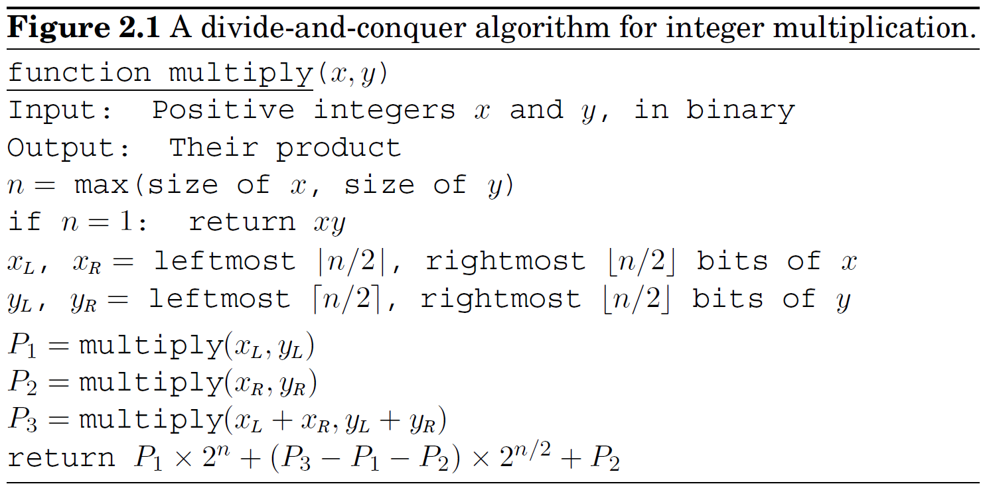
Multiplying Large Numbers--Karatsuba (1960)
Time Complexity:

Slide 5
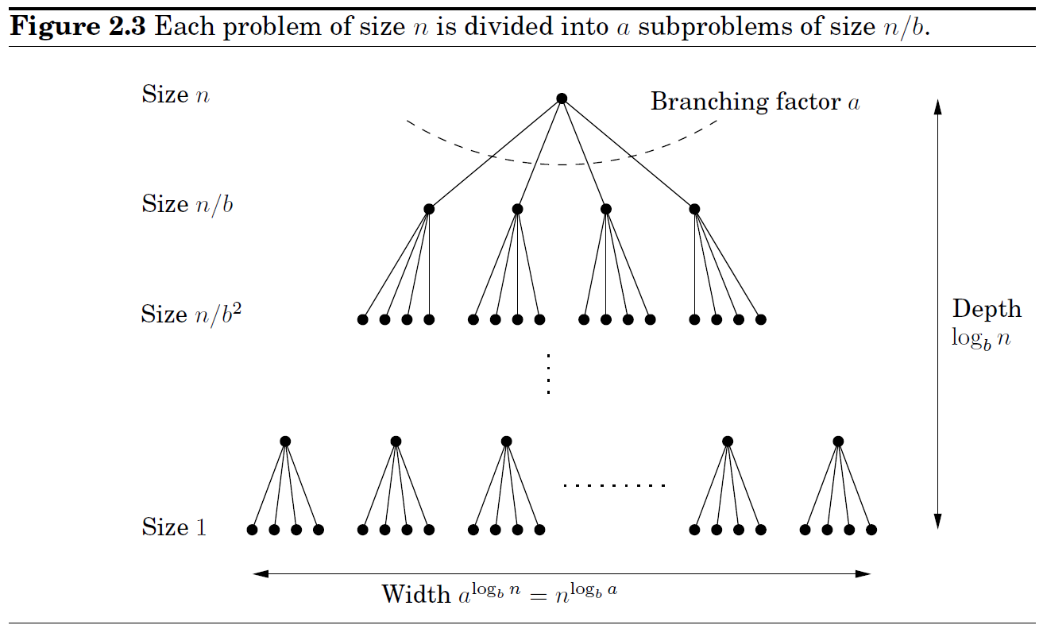
Recurrence Relations
Divide-and-conquer algorithms tackle a problem of size n by recursively solving a subproblems of size n/b and then combining the answers in O(n^{d}) time, for some a, b, d > 0 (Karatsuba, a = 3, b = 2, d = 1). Their running time can therefore be captured by the equation

Slide 6
Recurrence Relations
Master theorem. If for some constants a > 0, b > 1, and , then
Proof: Assume that n is a power of b. The height of the tree is . Its branching factor is a, so the kth level is made up of a^{k} subproblems, each of size n=b/k. The total work done at this level is
As k goes from 0 to log_{b}n, these numbers form a geometric series with ratio a/b^{d}. Finding the sum is easy, and comes down to three cases.
(1) a/b^{d} <1. The series decrease, its sum is given by its first term, O(n^{d}).
(2) a/b^{d} >1. The series increase, its sum is given by its last term, .
(3) a/b^{d} =1. All O(logn) terms of the series are equal to O(n^{d}).

Slide 7
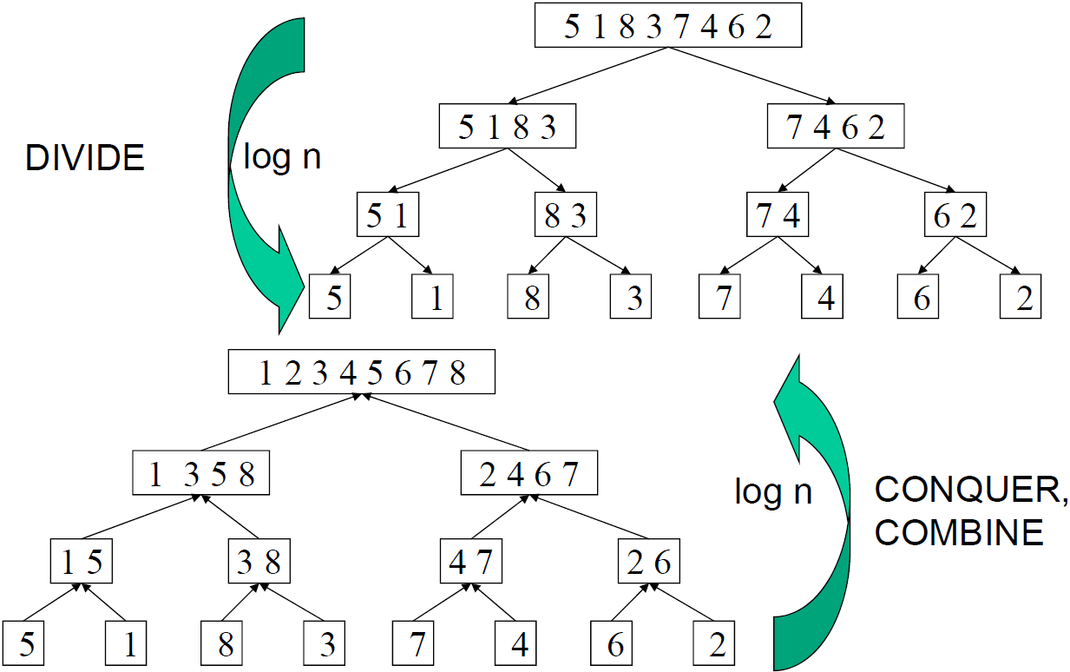
Mergesort
Problem: Sort a list of numbers.

Slide 8
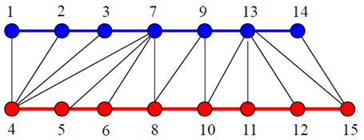
Mergesort
Problem: Sort a list of numbers.
function mergesort(a[1…n]) //T(n)=2T(n/2)+O(n)=O(nlogn)
if n > 1
return merge(mergesort(a[1…floor(n/2)]), mergesort(a[floor(n/2)+1…n]))
else
return a
function merge(x[1…k]; y[1…l]) //O(k+l)=O(n)
if k = 0 return y[1…l]
if l = 0 return x[1…k]
if x[1] ≤ y[1] return x[1]⸰merge(x[2…k]; y[1…l])
else return y[1]⸰merge(x[1…k]; y[2…l])

Slide 9
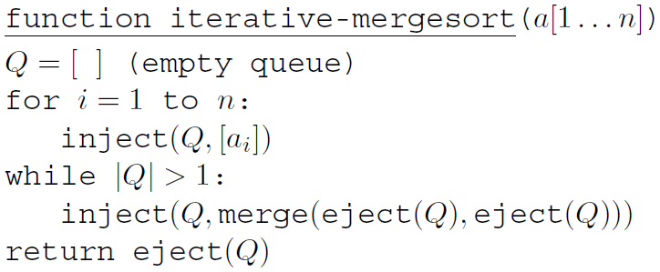
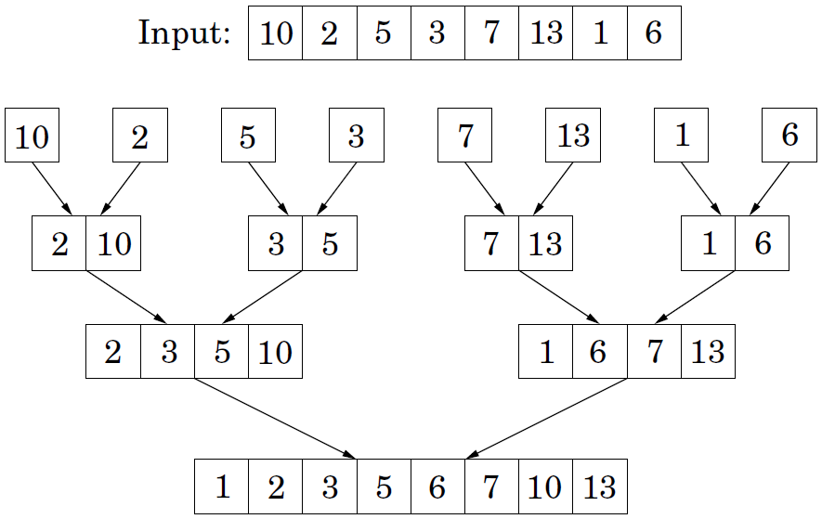
Mergesort
mergesort can be made iterative:

Slide 10
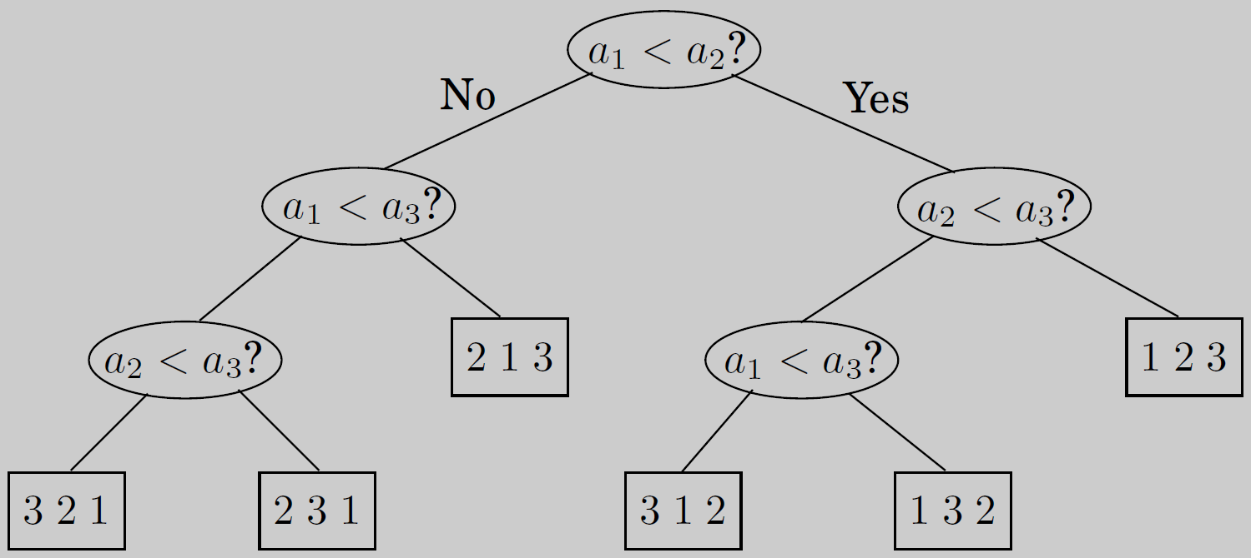
An nlogn lower bound for sorting
Sorting algorithms can be depicted as trees.
3!=6 leaves
the longest path from root to leaf = depth = worst-case time complexity
The depth of a tree with n! leaves is at least
Sorting algorithms that use comparisons is in Ω(nlogn)

Slide 11
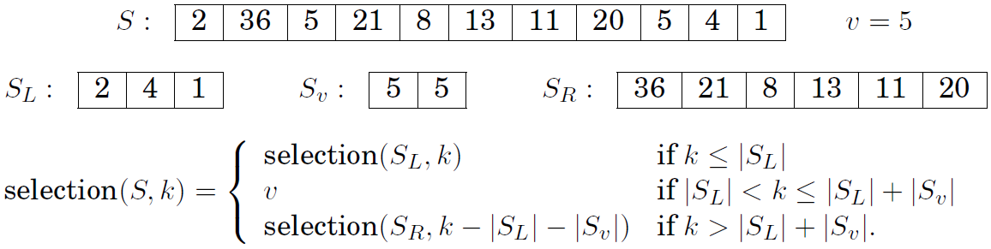
Medians
Median is faster than Sorting. A more general problem is easy to solve.
Problem: Selection
Input: A list of numbers S; an integer k
Output: The kth smallest element of S
For any number v, imagine splitting list S into three categories:
S_{L}, S_{v}, S_{R} can be computed from S in linear time, in place
Problem size:
pick v randomly from S
Expected running time: T(n) = T(n/2) + O(n)

Slide 12
Medians
Time Complexity: (pick v randomly from S)
Best: split the array perfectly in half.
Worst: |S_{L}|=1, or |S_{R}|=1.
Average:
Good element: lies within the 25th to 75th percentile of a array.
The probability that a random v is good is 1/2.
Two operations on average shrink to at most 3/4 in the array size.
Lemma: On average a fair coin needs to be tossed two times before a head is seen.
Proof. Let E be the expected number of tosses before a heads is seen. We certainly need at least one toss, and if it's heads, we're done. If it's tails (with probability 1/2), we need to repeat. Hence E = 1+1/2E, which works out to E = 2.

Slide 13
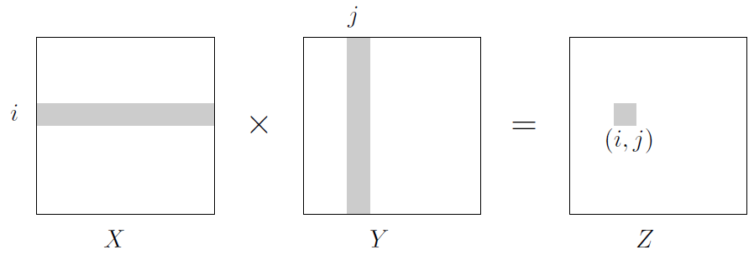
Matrix Multiplication
Problem: The product of two matrices X and Y
Standard algorithm
Block matrix multiplication

Slide 14
Matrix Multiplication—Volker Strassen (1969)
The Volker Strassen Algorithm:
Time Complexity: T(n) = 7T(n/2) + O(n²)

Slide 15
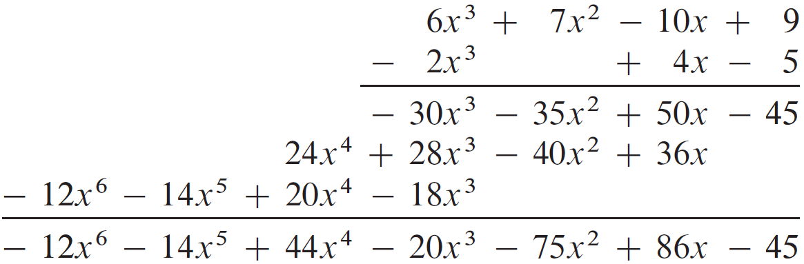
Polynomial Multiplication
Polynomial: A(x)=a₀+a₁x+…+a_{n-1}x^{n-1}
Coefficient representation: a₀, a₁ , … , a_{n-1}
Value representation: A(x₀), A(x₁), …, A(x_{n-1})
Polynomial multiplication in the coefficient representation

Slide 16
Polynomial Multiplication
Polynomial multiplication in the value representation
Is it helpful in multiplying polynomials in the coefficient representation?

Slide 17
Evaluation
Horner's rule: Evaluate A(x₀) . So Evaluation

Slide 18
Evaluation - Fast Fourier Transformation
Fast Fourier Transformation dose the evaluation for special points in the complex plane

Slide 19
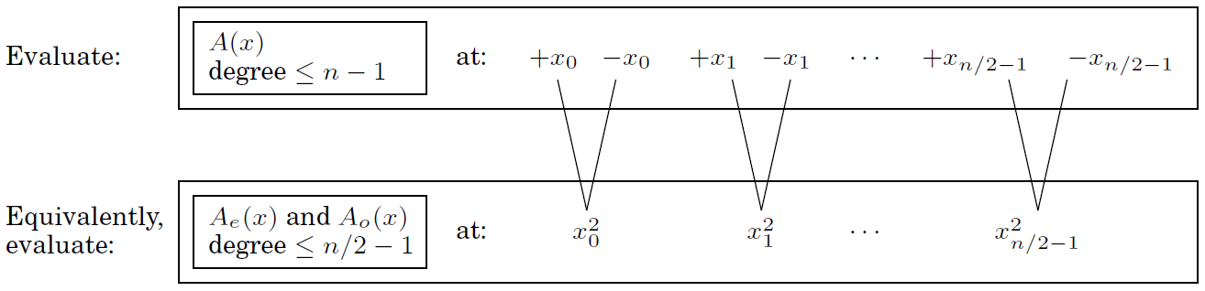
Evaluation
A_{e}(x) = 3+6x+5x²: degree ≤ n/2, with the even-numbered coefficients
A_{o}(x) = 4+2x+9x²: degree ≤ n/2, with the odd-numbered coefficients
The calculations needed for A(x) can be recycled toward computing A(-x)
A(x) = A_{e}(x²) + xA_{o}(x²)
A(-x) = A_{e}(x²) - xA_{o}(x²)
Must recurse at the next level. The complex roots of 1 are perfect!

Slide 20
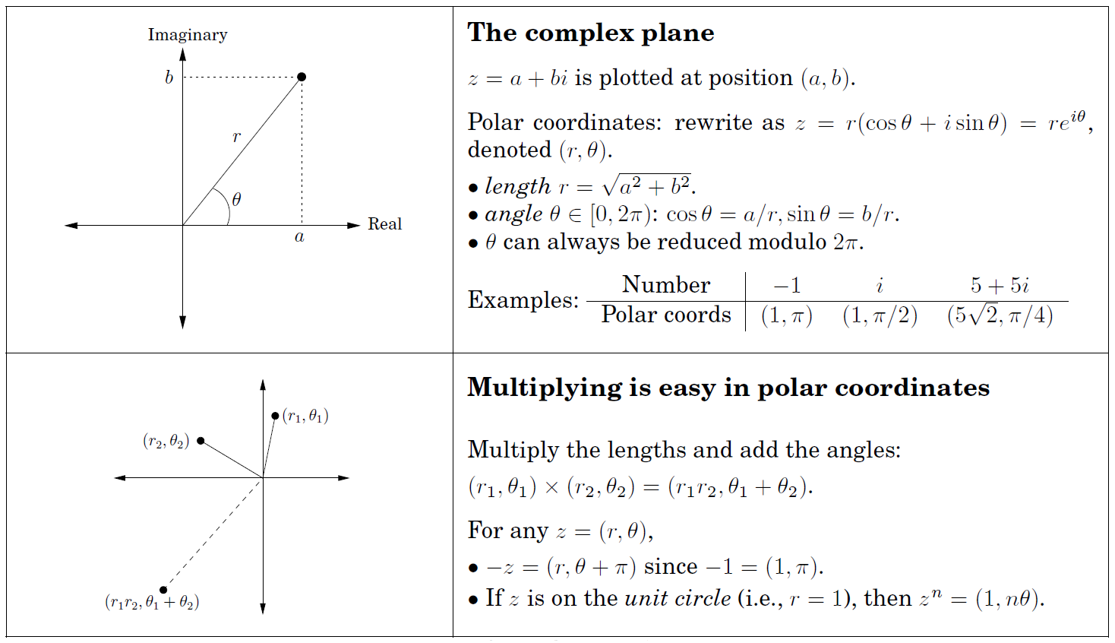
The complex roots of unity

Slide 21
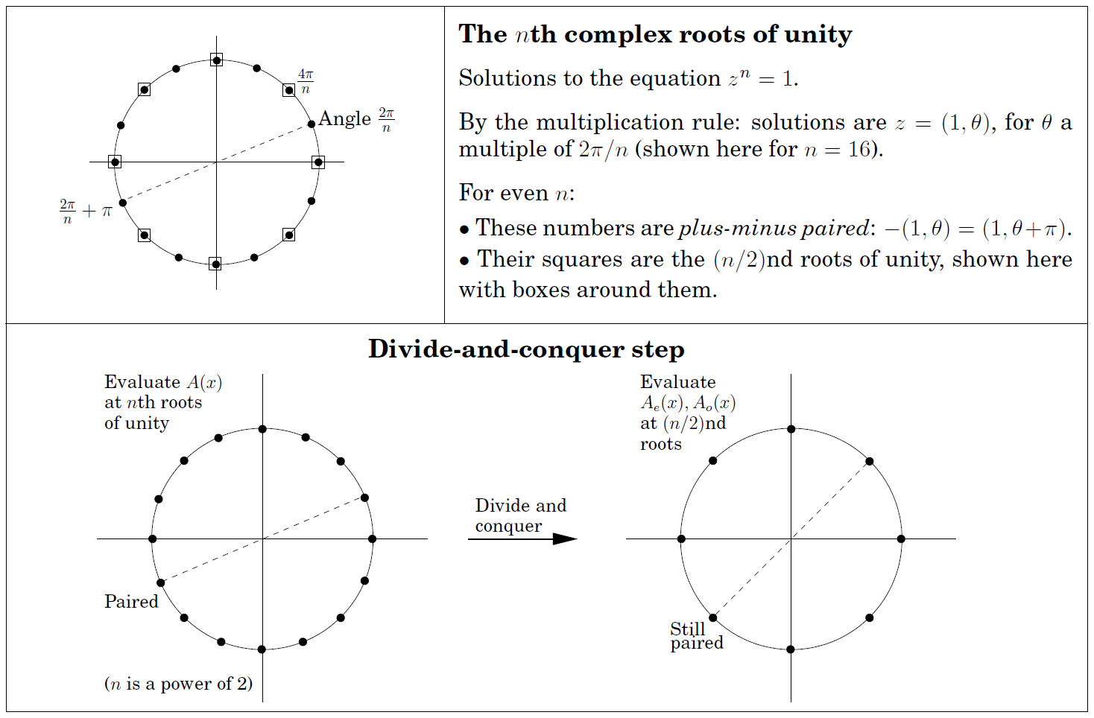
The complex roots of unity

Slide 22
Polynomial Multiplication
FFT Evaluation .

Slide 23
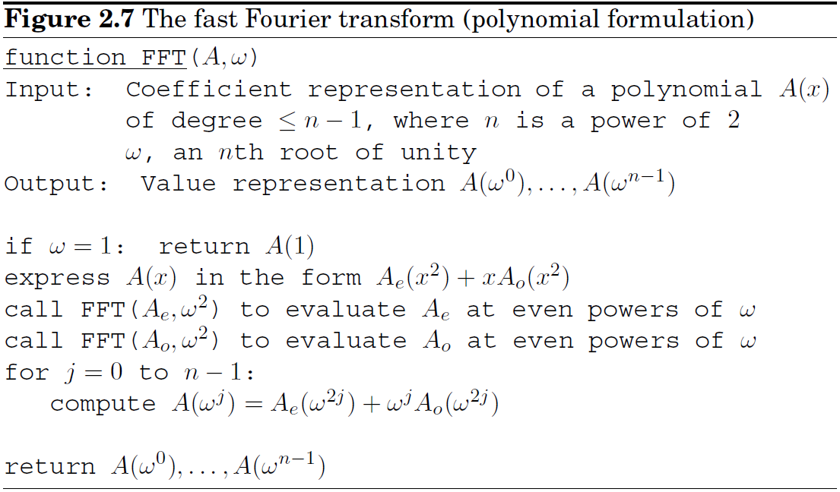
Evaluation - Fast Fourier Transform
Fast Fourier Transform

Slide 24
Polynomial Multiplication
FFT Evaluation . Interpolation?

Slide 25
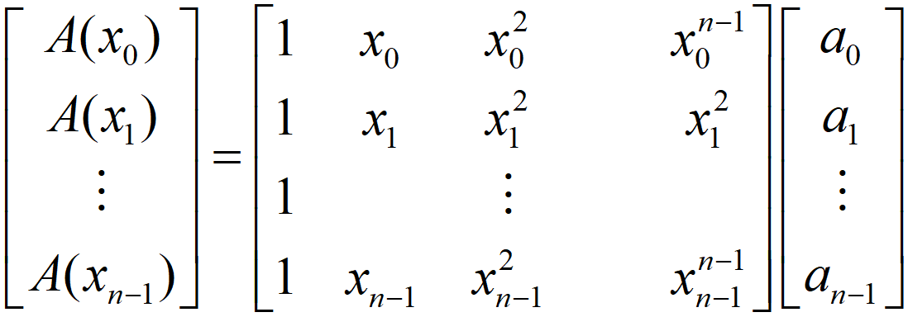
Interpolation
Evaluation:
Interpolation:
Vandermonde matrix M: If , then M is invertible.
Matrix inversion
Vandermonde matrix inversion
Can we do better?

Slide 26
Interpolation
FFT Evaluation:
Fourier basis: the columns of M(ω) that are orthogonal to each other.
FFT is a change of basis, a rigid rotation. M(ω)⁻¹ is the opposite rotation.
Inversion formula:

Slide 27
Polynomial Multiplication
Polynomial Multiplication .

Slide 28
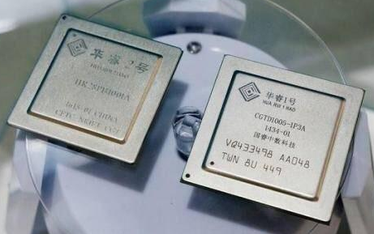


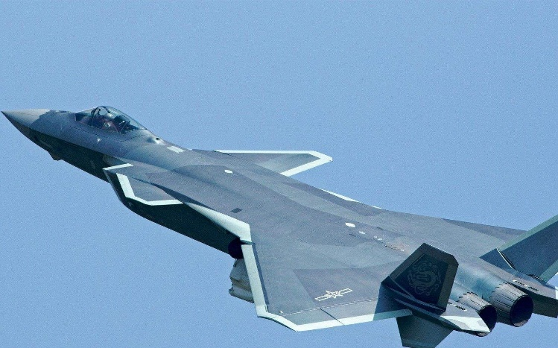
FFT的应用
FFT是最基本的数字
信号处理算法之一，
常被固化于DSP内。
中国电子科技集团有限公司第十四研究所所长胡明春：经过几十年的不断发展，我国雷达已全面接近或达到国外先进水平，整体上全面处于并跑状态，正处于从“跟跑”到“领跑”跨越的关口期，并且在某些领域已经实现了“领跑”。

